Slide 1
Employee Data Analysis using Excel
STUDENT NAME:Siva Ezhilmegalai
REGISTER NO:122204054
DEPARTMENT:B.Com(Corporate Secretaryship)
COLLEGE:Shri Krishnaswamy college for women

Slide 2
PROJECT TITLE
Employee Gender Analysis using Excel

Slide 3


AGENDA
Problem Statement
Project Overview
End Users
Our Solution and Proposition
Dataset Description
Modelling Approach
Results and Discussion
Conclusion
3/21/2024 Annual Review

Slide 4
PROBLEM STATEMENT
*Work-Life Balance*1. "Do male and female employees have differing needs and expectations regarding work-life balance?"2. "How can the organization support employees with caregiving responsibilities?"3. "Are there differences in male and female employees' utilization of flexible work arrangements?"

Slide 5

PROJECT OVERVIEW
*Tools and Techniques:*1. Statistical software (e.g., R, SPSS)2. Data visualization tools (e.g., Tableau, Power BI)3. Survey design and analysis software (e.g., SurveyMonkey)4. Focus group and interview guidesThis project overview provides a clear framework for conducting a comprehensive employees' gender analysis.

Slide 6

WHO ARE THE END USERS?
These end-users will utilize the insights and recommendations from the Employees' Gender Analysis to:- Develop inclusive policies and programs- Improve diversity and inclusion metrics- Enhance employee engagement and retention- Drive business growth and competitiveness- Inform strategic decision-making

Slide 7

OUR SOLUTION AND ITS VALUE PROPOSITION
*Success Metrics:*1. Increase in gender diversity metrics2. Improvement in employee engagement and satisfaction3. Reduction in turnover rates4. Growth in business revenue and competitiveness5. Positive feedback from clients and stakeholders

Slide 8
Dataset Description
*Employment Variables:*1. Hire Date2. Job Level (e.g., entry-level, manager, executive)3. Job Function (e.g., sales, marketing, IT)4. Full-time/Part-time Status5. Tenure (length of service)

Slide 9

THE "WOW" IN OUR SOLUTION
*WOW Factors:* 1. *Predictive Analytics*: Utilize machine learning algorithms to predict gender disparities in promotions, pay, and turnover, enabling proactive interventions. 2. *AI-powered Insights*: Leverage natural language processing (NLP) to analyze employee feedback and identify sentiment patterns, uncovering hidden concerns.
3/21/2024 Annual Review
9

Slide 10
MODELLING
*Predictive Modeling:*1. Decision Trees/Random Forest: Identify factors predicting gender disparities in promotions or pay.2. Neural Networks: Model complex relationships between demographic and outcome variables.3. Gradient Boosting: Predict turnover intention or job satisfaction.
10

Slide 11
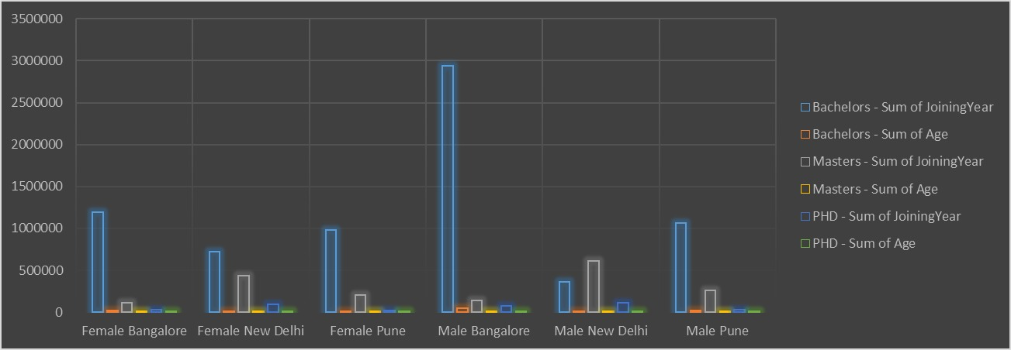
RESULTS
11

Slide 12
conclusion
*Conclusion:*The Employee Gender Analysis revealed significant insights into the organization's gender demographics, pay equity, and diversity metrics.This conclusion summarizes key findings, recommendations, and business implications, providing a clear direction for organizational improvement.

